Slide 1
What is Cloud Computing?

Slide 2
Overview
What is Cloud Computing?
NIST Definition of Cloud Computing
Essential Characteristics of Cloud computing
Cloud Deployment Models
Cloud Service Models
Business Drivers for Cloud Computing
Considerations for Cloud Adoption
What is Amazon Web Services?

Slide 3
Key Terminology
Data Center – A facility used by organizations to house and manage data. The core elements of a data center include hardware components such as compute, storage, networks, etc. and software components such as applications and operating systems.
Cloud User – a person or organization requesting cloud resources and services (terms user, client, customer, or consumer may also be alternately used)
Cloud Service Provider (CSP) - An organization that provides a cloud platform, infrastructure, applications, and services
Multitenancy – is an architecture common to cloud computing where multiple customers (tenants) of a cloud service provider share the available resources without the knowledge of one another
Cloud-native – specifically designed for the cloud environment
Vendor lock-in – Reliance on proprietary software or technology that restricts organizations from adopting alternative solutions easily and without significant costs
Economies of scale – is the relationship between the per-unit cost and the production volume; an increase in production leads to a decrease in per-unit cost by spreading out the costs over more units.
Organizational Agility – is the ability of an organization to quickly adapt to the changes in the market or industry

Slide 4
Key Terminology - 2
Capital Expenses (CAPEX) – Costs associated with fixed assets including their purchase, maintenance, and improvement; an IT example would be purchasing land, computing equipment, software, etc.
Operational Expenses (OPEX) – costs associated with the day-to-day running of a business; an IT example would be Internet costs, licensing fees, etc.
Vertical scaling – involves adding resources such as memory, processing power, etc. to the same node.
Horizontal scaling – involves adding more nodes to a distributed system
Total Cost of Ownership (TCO) - Complete cost of an object or service throughout its lifetime, from purchase to disposal, including direct and indirect costs
Barrier to entry – This is an economics or business term which means the obstacles for a new company to enter a given market.
Monolithic application – designed as a single unit
Microservices-based application – an application that is broken down into many loosely-coupled services that interact with each other
Serverless – independent of the need to provision or manage servers

Slide 5
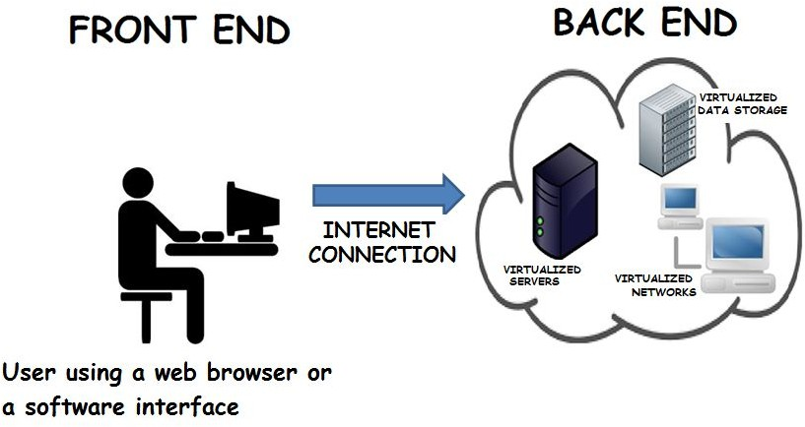
What is Cloud Computing?
An on-demand delivery of servers, storage, database, applications and other IT resources as services over the Internet.
The resources requested by the user are typically hosted in large data centers by CSPs such as Amazon Web Services (AWS), Microsoft Azure, Google, etc. in different locations across the globe. Details of system implementation are
abstracted (hidden) from the user.
5

Slide 6
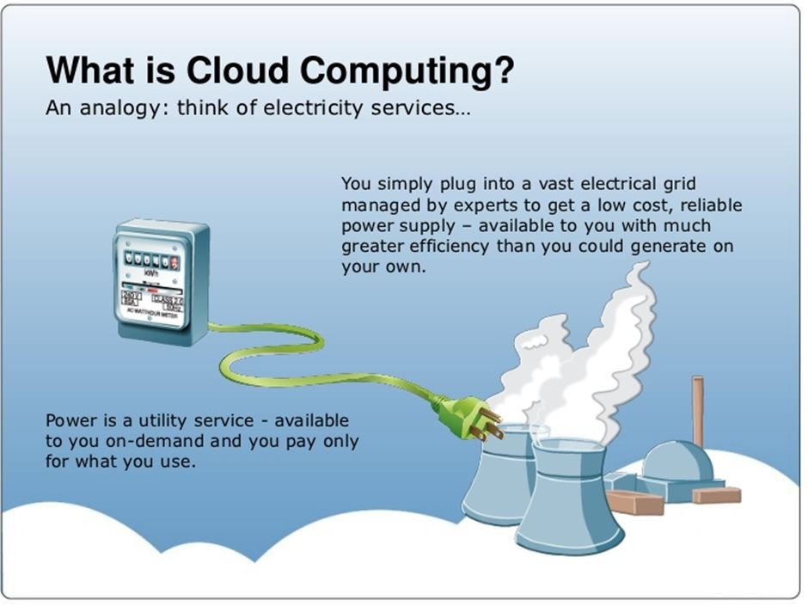
Source: AWS
6
6

Slide 7
The NIST Cloud Model
The US National Institute of Standards and Technology (NIST) Special Publication 800-145 is a widely accepted standard that will be the premise of our next discussion.
The standard includes the definition of Cloud Computing and describes five essential characteristics, four deployment models, and three service models.

Slide 8
NIST Definition of Cloud Computing
Cloud computing is a model for enabling ubiquitous, convenient, on-demand network access to a shared pool of configurable computing resources (e.g., networks, servers, storage, applications and services) that can be rapidly provisioned and released with minimal management effort or service provider interaction.
-NIST
It is a very common misconception among people that cloud computing is a technology. Cloud computing is in fact a business or a service model that relies on enabling technologies such as virtualization and storage.

Slide 9
Essential Characteristics of Cloud Computing
On-demand Self Service: A user can provision resources as needed automatically without needing any human interaction with the service provider
Broad network access: Access to resources is available via different client platforms such as phones, tablets, laptops, workstations, etc.
Resource pooling: The service provider creates pools of resources i.e., servers, storage, etc., to serve multiple consumers (multitenancy).
Rapid Elasticity: Resources can be provisioned or released to match demand. For e.g., virtual machines can be added when demand grows and terminated when demand drops.
Measured Service: Resource usage is monitored, controlled and reported, providing transparency to both the provider and consumer. Billing is based on actual consumption of services using a “pay as you go” model (similar to consuming electricity ).
Other terms with similar meaning to pay as you go are pay-per-use.

Slide 10
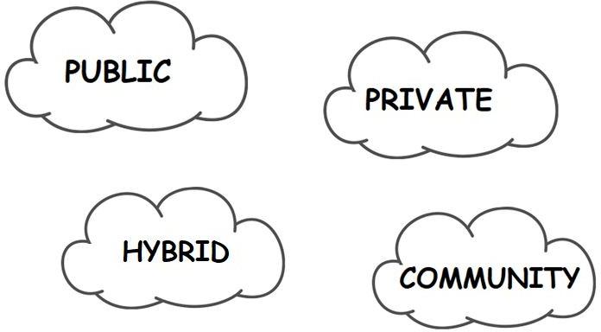
Cloud Deployment Models
A deployment model defines who the user of that cloud is and where the cloud infrastructure resides.

Slide 11
Public Cloud
Cloud infrastructure is provisioned for the general public to use.
Exists on the premises of the CSP
Consumers use the cloud services offered by the providers via the Internet and pay metered usage charges (most closely resembles the utility model that was discussed in the beginning).
Most cost-effective through multitenancy, enormous scalability
Enterprises do not control location of data and equipment (this may be a concern for organizations with regulatory or legislative mandates).
For e.g., AWS, Google, Salesforce

Slide 12
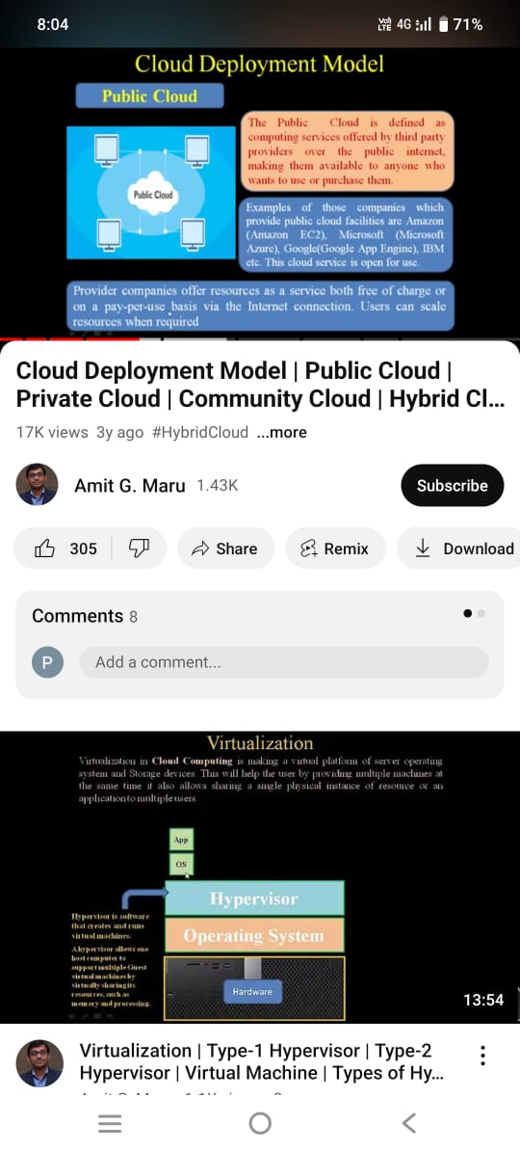

Slide 13
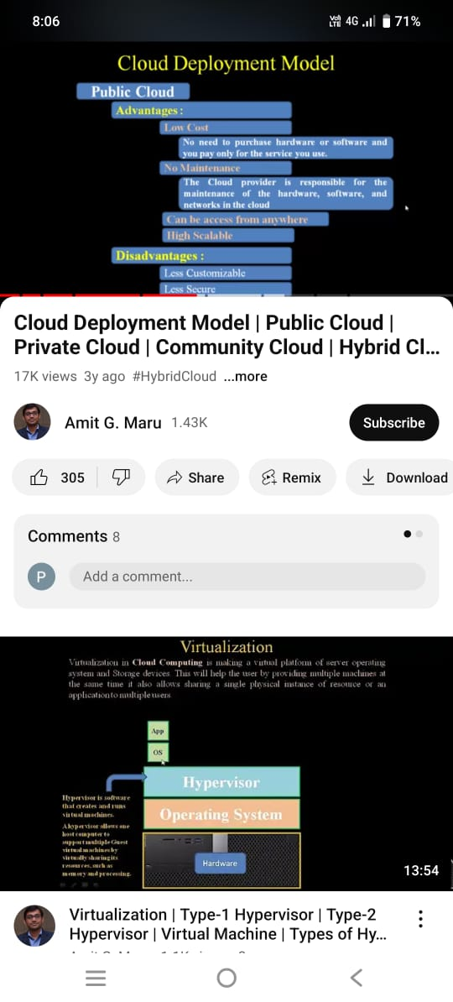

Slide 14
Private Cloud
For exclusive use by a single organization with multiple consumers (e.g., departments or business units)
Infrastructure is owned and managed by the organization on-premise¹ (cost-intensive).
Requires in-house IT skills and expertise
Better control over data location and security, but limited scalability
Preferred choice for companies that already own a data center and developed IT infrastructure or driven by legal and compliance requirements.
¹ In the event that the organization does not have the expertise to manage their own infrastructure or for cost reasons, a private cloud can also be managed by a third party and hosted off-premise.
12

Slide 15
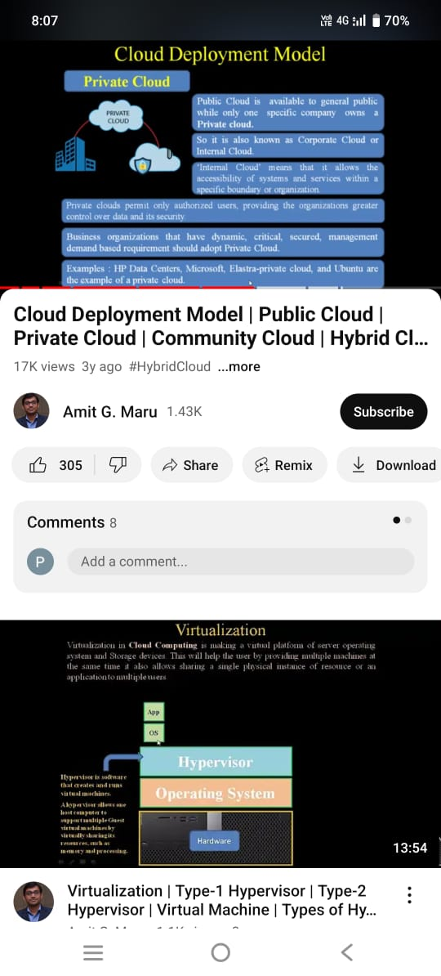

Slide 16
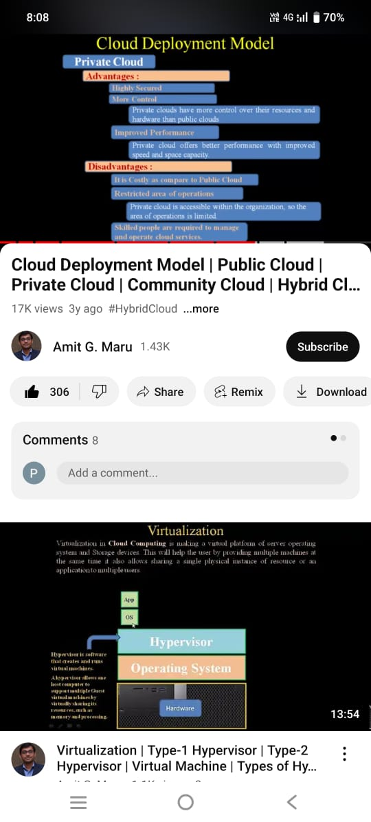

Slide 17
Hybrid Cloud
A combination of public and private (or other) cloud models
The models are unique entities but are bridged together by standardized or proprietary technology that enables data and application portability.
Harder management, but allow better alignment to business needs
For e.g., an organization with its own data center facility may choose to utilize the services of a public cloud for inexpensive data backup.

Slide 18
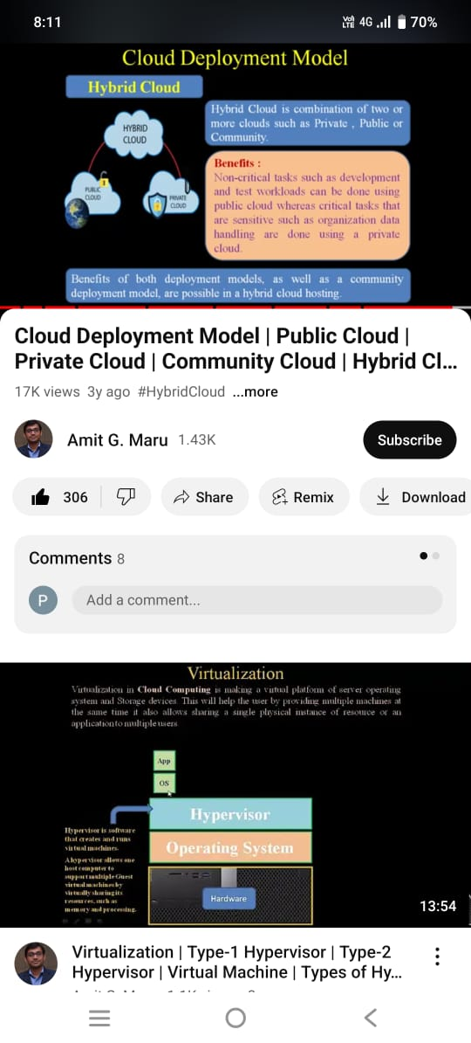

Slide 19
Cloud Bursting using Hybrid Clouds
Use of private cloud resources to support applications
When spike in demand exceeds local resource limits, bursts are managed by the public cloud.
For e.g., a tax preparation service company may experience a tremendous increase in volume (two to three times their usual) during tax season. If the company buys resources on-premise to meet their peak load in a year, most of the resources will remain idle for the rest of the year. A good strategy would be to invest in resources
on-premise that meet typical load. When the traffic hits peak, they can utilize a public cloud for the heavy lifting.

Slide 20
Community Cloud
Cloud infrastructure is provisioned for use by multiple organizations with shared concerns (e.g., mission, security requirements, policy, compliance considerations).
Owned, managed, and operated by the organizations themselves or a third party
On- or off-premise
For e.g., US Government agencies with similar requirements for security, privacy, audit, etc. can use a Community cloud.

Slide 21
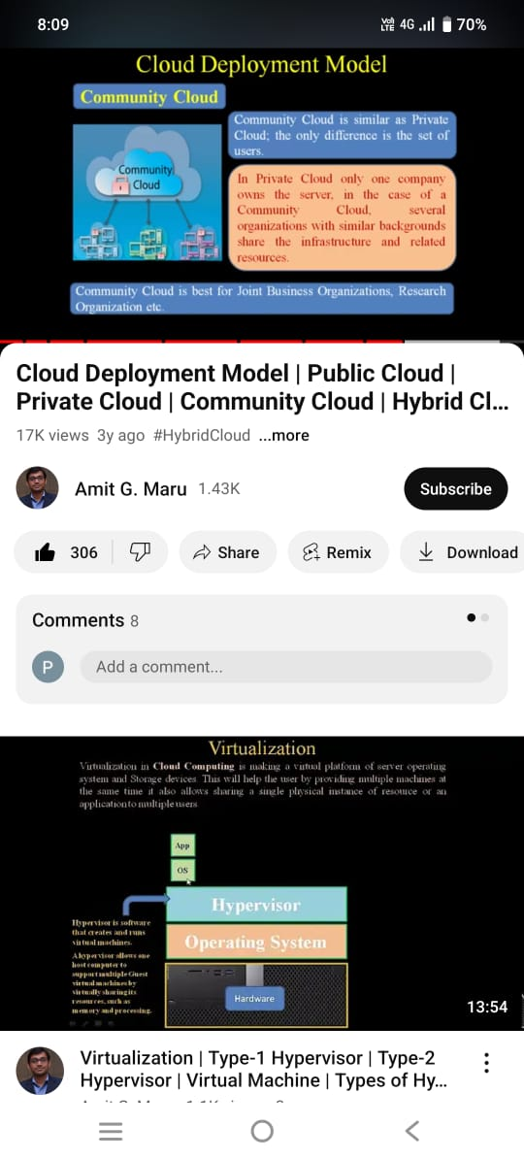

Slide 22
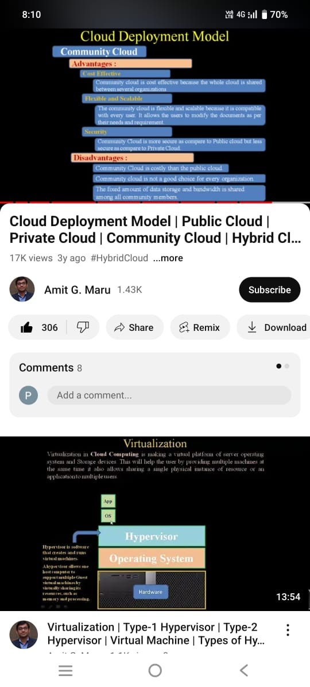

Slide 23
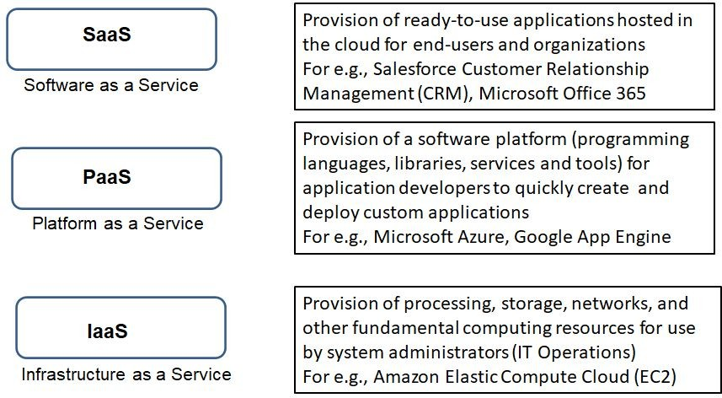
Cloud Service Models
A Service model defines the type of service that the cloud provider is offering.
“as a service” implies that SaaS, PaaS, and IaaS are delivered by way of software

Slide 24
Characteristics of IaaS
Provision of hardware
IaaS reduces or eliminates capital costs and complexities of owning hardware (why buy servers when you can rent them?).
CSP manages the infrastructure; the client is responsible for other aspects of the deployment such as operating system and applications
IaaS is the base layer of the cloud services stack and serves as the foundation for both PaaS and SaaS.

Slide 25
Characteristics of PaaS
Provides an environment for low-cost and rapid development of new applications (e.g., web and mobile).
Most platforms are accessed through an Application programming interface or API.
Application developers have complete control over deployed applications and configuration settings for the application-hosting environment, but do
not manage or control the underlying cloud infrastructure networks, servers, storage, or operating systems.
High risk of vendor lock-in
including

Slide 26
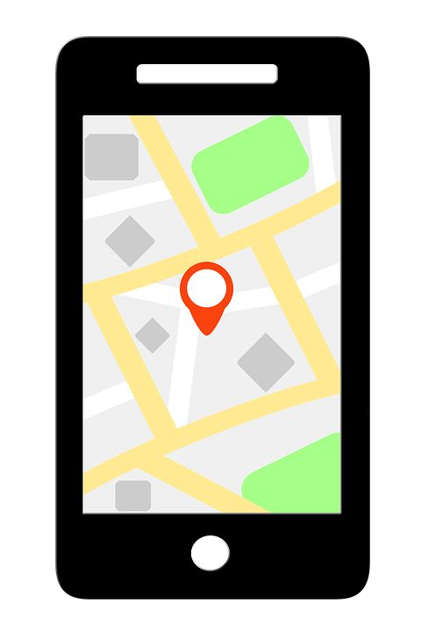
What is an API?
An API allows one piece of software talk to another.
An API defines how a programmer can write a piece of software to extend an existing application’s features or even build entirely new applications.
Source: Cisco

Slide 27
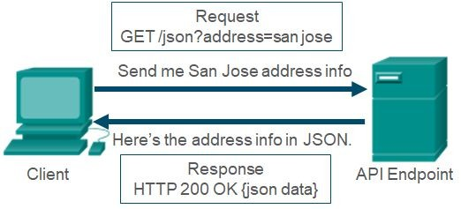
API using HTTP
Developers construct API requests using HyperText Transfer Protocol or HTTP.
The HTTP request asks for JSON formatted data.
If successfully formatted according to the API documentation, the server will respond with JSON data.
Source: Cisco
JSON = JavaScript Object Notation

Slide 28
Characteristics of SaaS
Most popular service
SaaS applications are cloud-native and multitenant.
Applications are prebuilt and consumed without significant customization.
Deployment and maintenance including patching and updates of the application software is handled by the CSP.
Users simply use the software; they do not control or manage the underlying infrastructure
Applications can be accessed anytime from anywhere using any client device (device and location independence).
21

Slide 29
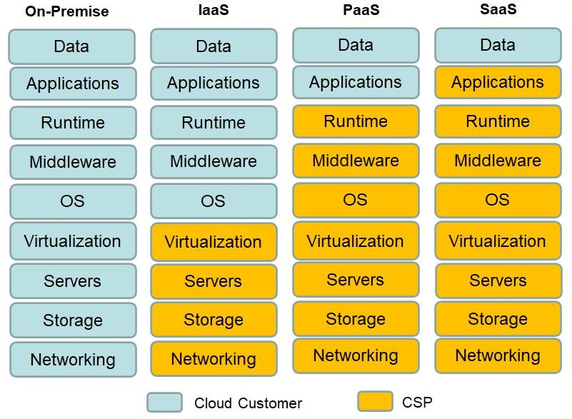
Shared Responsibility Model
The figure depicts how responsibilities are shared between two parties, the CSP and the Cloud Customer and how they vary based on the service model chosen.
As you can clearly see, with an on-premise deployment, an organization manages everything.
With IaaS, the CSP manages the infrastructure components including servers, storage devices, networking equipment, and the virtualization software. The operating system deployed on individual virtual machines including patching and upgrades, applications, and data fall under the customer’s purview.
Customer responsibilities diminish as we move away from IaaS to PaaS to SaaS. No matter what the service model, the organization is always responsible for its data in the cloud.

Slide 30
Business Drivers for Cloud Computing
For most businesses, IT has become a necessity. Hosting IT services in-house can be costly and distract businesses from focusing on their core competencies.
Two major business drivers for Cloud are lower costs and increase in agility.
23

Slide 31
Reducing Costs
Lower costs from economies of scale
Public CSPs support thousands of customers
They are able to offer services at reasonable pricing due to economies of scale
Customers can avail of multiple pricing options based on their workload requirements.
Shift from CAPEX to OPEX (variable)
No upfront costs of purchasing and maintaining hardware on-premise)
Only pay for resources or services consumed (pay-per-use)
(except
when
24

Slide 32
Increasing Agility
On-demand Scalability and Elasticity
Ability to scale resources up¹ or down and out² or in based on need
Obviates need for guessing, planning, or provisioning capacity
Faster time to market
Organizations can quickly deploy development and testing environments in the cloud.
Provides opportunities to experiment, innovate, and rapidly develop new products
More Focus on Core Business
Cloud adoption transfers many routine administrative duties to the CSP.
IT staff can focus their time on more important business goals.
Global access
Applications can be deployed in multiple geographic regions across the globe to provide lower latency and improved experience to users.
¹ Scaling up is also known as vertical scaling.
² Scaling out is also known as horizontal scaling.
If both are used, it is referred to as diagonal scaling
25

Slide 33
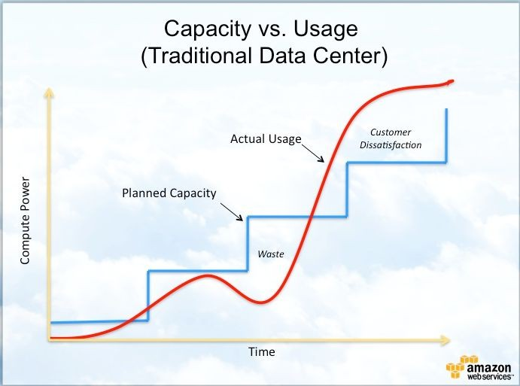
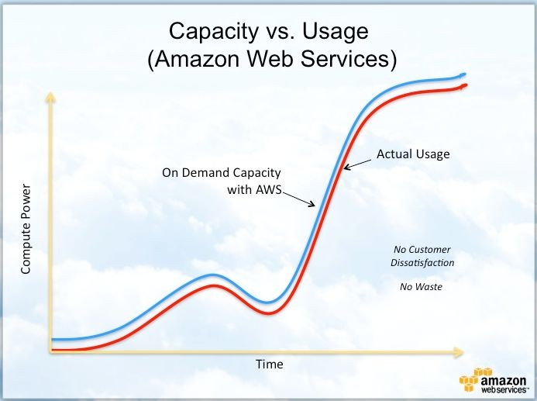
Capacity Provisioning Traditional Data Center vs. Cloud
Source: AWS
The figure on the right shows how capacity provisioning with AWS closely follows the demand curve resulting in no waste or customer dissatisfaction.

Slide 34
Considerations for Cloud Adoption
Organizations must consider various factors before moving their business processes to the cloud.
Choosing the right Deployment model
The greatest barrier to entry for startup companies is capital. For startups, public cloud solutions offer the advantage of reduced costs which outweighs other risks.
Small-to-Medium sized businesses with a moderate customer base may prefer hybrid cloud deployments. These enable them to run mission-critical applications on their private cloud while less critical applications can be deployed in a public cloud.
Enterprises have a large customer base across the globe. They are financially capable and may prefer private cloud deployment that enables them to control data location, security, etc.
Migrate or retain?
Mission-critical applications are best run in an on-premise environment or in the private cloud.
Regulatory and compliance requirements may prevent moving applications using sensitive information to the public cloud.
Legacy applications or applications that require proprietary technology should be run in-house.
Applications with dependencies on resources or other applications residing in a private data center may suffer from performance (latency) issues if migrated to the public cloud.

Slide 35
Considerations for Cloud Adoption - 2
Non-critical, low-risk applications such as collaboration (email, web conferencing, etc.), personal productivity (word processing, spreadsheets, etc.), development and testing, etc. make a good fit for migration to the public cloud.
Choosing a Cloud Service Provider
How long has the provider been in business?
Can the provider meet the current and future requirements of the organization?
How easy is it to add or remove services?
Can applications and services be easily transferred to another provider at the end of the contract?
Does the provider notify clients of maintenance windows and is that downtime scheduled?

Slide 36
Is there a Cost Advantage?
It is important for organizations to compare the TCO for an on-premise environment versus the public cloud environment to identify if there is any potential benefit in cloud adoption.
If an organization owns and maintains its own data center, the TCO calculation will include both capital and operational expenses. CAPEX involves costs for data center facilities, servers, storage devices, network equipment, operating systems, etc. Examples of OPEX include costs for power and cooling, personnel, Internet service, etc.
Cloud adoption costs will include migration costs, usage fees for cloud services, plus costs to ensure security and compliance.
CSPs such as Amazon Web Services provide free online TCO calculators that can be useful for such financial analysis. AWS Pricing calculator (https://calculator.aws/#/) is another free tool that can aid in TCO calculation by creating cost estimates for AWS services that an organization may utilize.

Slide 37
Strategies for Application Migration
Organizations must carefully review their existing applications and choose strategies that best match with their business needs such as cost savings, improved scalability, availability, etc. Here is a summary of some common strategies:
Rehosting (Lift-and-shift) –
Redeploying an on-premise applications into a cloud IaaS environment
Utilized to meet business needs quickly without any optimizations
Fastest to perform but does not utilize full potential of the cloud
Can be performed manually or through automated tools such as AWS VM Import/Export (allows organizations to export virtual machine images from on-premise environment into Amazon EC2 instances)
Re-platforming
Involves optimizations without changing the core architecture of applications
For e.g., to reduce the administrative overhead of managing their on-premise database solution, an organization may consider migrating to a fully managed database service such as Amazon Relational Database Service (RDS). With a managed service, the CSP is responsible for most administrative tasks.
Repurchasing
Investing in SaaS applications (cloud-native) i.e., moving to a different product
Frees the IT staff of maintenance and updates
For e.g., moving an HR system to Workday, moving Microsoft Outlook to Office 365, in-house CRM solution to Salesforce
Rebuilding/ Re-architecting
Changing the core architecture of applications; for e.g., transforming a monolithic application into a microservices-based application or going serverless (we will discuss these terms in Chapter 3)
Goal is to achieve considerable increase in performance, scale, agility or new features
Most expensive option

Slide 38
Service Level Agreements (SLAs)
An SLA is a contract between a customer and a CSP that specifies the level of uptime that will be supported by the provider as well as the expected performance metrics.
Should include provision for how the CSP will compensate cloud consumers if SLAs are not met (e.g., monetary compensation or service credits)
SLAs are specific to a cloud service i.e., SLA for cloud storage may differ from the SLA for cloud virtual machines.
An SLA may describe a single service that is provided to all customers uniformly or it could be a custom agreement unique between a customer and the CSP.
SLAs are an important part of ensuring adequate availability of key resources so that organizations can continue doing business and not suffer excessive losses.

Slide 39
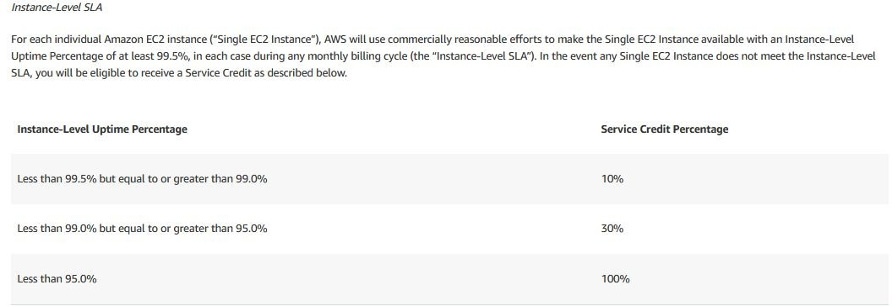
An Example of SLA
Source: AWS
The above is an example of an Instance-level SLA that AWS has specified on their website for each individual Amazon EC2 instance.
An Amazon Elastic Compute Cloud or EC2 instance is synonymous to a virtual machine deployed in the AWS cloud.

Slide 40
Current Trends
The current trend in the industry is “Multi-cloud”. Multi-cloud is the use of cloud services from more than one cloud vendor.
Each cloud vendor such as AWS, Azure, Google, etc. continues to offer a myriad of services for organizations to use. A service offered by one cloud vendor may be better than other vendors in terms of performance, easy of use, cost, compliance, etc.
Multi-cloud gives organizations the flexibility to choose a service from a vendor that best fits their needs and may also prevent vendor lock-in.
Though very appealing, the obvious pitfall is management complexity.

Slide 41
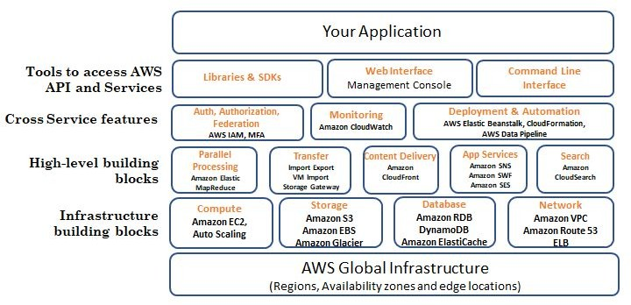
What is Amazon Web Services?
Amazon Web Services (AWS) was founded in March 2006 and is the world’s largest public cloud service provider today.
AWS provides a broad range of core services such as compute, storage, database, networking, and other functional services over its Global Infrastructure comprising of Regions, Availability Zones, and Edge Locations.
AWS services can be accessed using either the management console (think of this as a GUI interface), Command Line Interface (CLI) which allows scripts, or Software Development Toolkits (SDKs) which is an option preferred by developers and supports multiple programming languages such as Python, Java, PHP, Ruby, C++, etc..

Slide 42
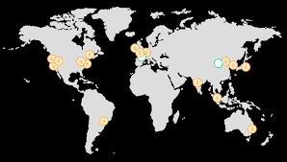
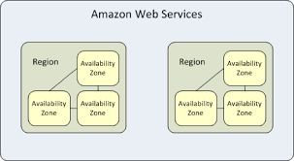
Understanding the AWS Landscape
AWS Regions on the world map
Availability Zones within Regions in AWS
Source: AWS
Source: AWS
The AWS footprint consists of several geographic “Regions” spread across the globe. Each Region comprises of multiple, physically separate Availability Zones. The typical number is three.
An “Availability Zone” is a cluster of one or more discrete data centers. The AZs are powered independently and separated from the other AZs within the Region by about 100 kms or 60 miles. AZs within a Region are interconnected using high-throughput metro fiber connections.
Click https://aws.amazon.com/about-aws/global-infrastructure/regions_az/ for more information.
35

